Slide 1
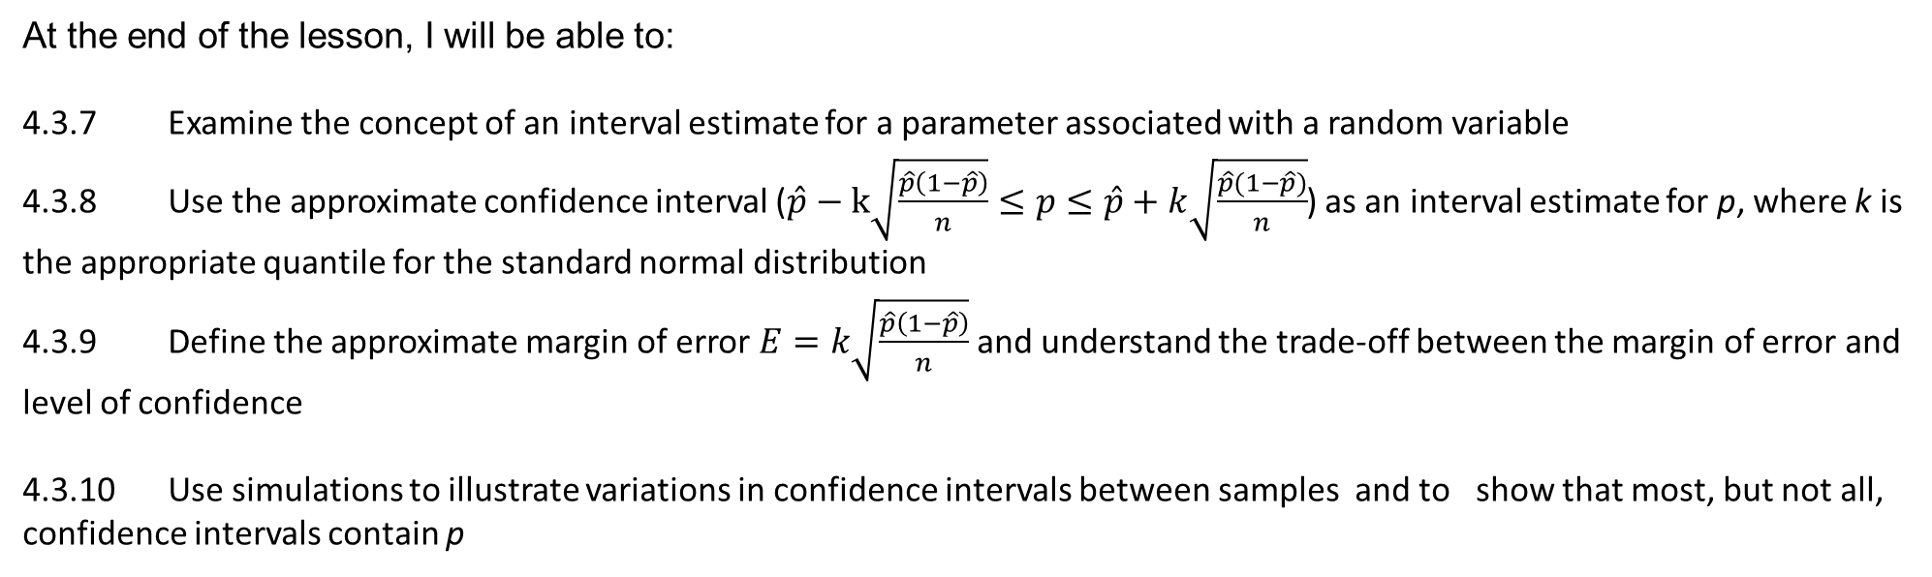
Learning Objective
I will be able to interpret the confidence interval for the sample proportion
Success Criteria
At the end of the lesson, I will be able to:
4.3.7 Examine the concept of an interval estimate for a parameter associated with a random variable
4.3.8 Use the approximate confidence interval ($\hat{p}−k\sqrt{\frac{\hat{p}\left(1−\hat{p}\right)}{n}}≤p≤\hat{p}+k\sqrt{\frac{\hat{p}(1−\hat{p})}{n}}$) as an interval estimate for p, where k is the appropriate quantile for the standard normal distribution
4.3.9 Define the approximate margin of error $E=k\sqrt{\frac{\hat{p}\left(1−\hat{p}\right)}{n}}$ and understand the trade-off between the margin of error and level of confidence
4.3.10 Use simulations to illustrate variations in confidence intervals between samples and to show that most, but not all, confidence intervals contain p

Slide 2
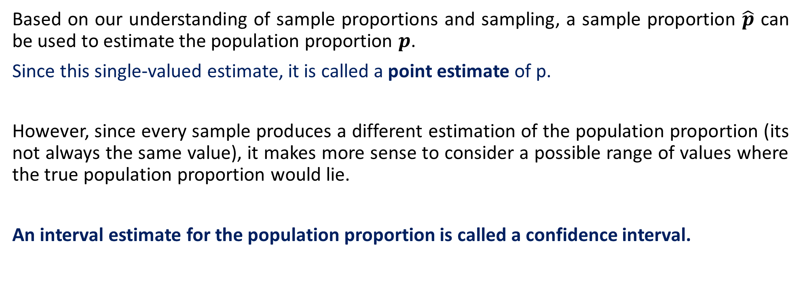
Point and Interval Estimates
Based on our understanding of sample proportions and sampling, a sample proportion $\hat{p}$ can be used to estimate the population proportion $p$.
Since this single-valued estimate, it is called a point estimate of p.
However, since every sample produces a different estimation of the population proportion (its not always the same value), it makes more sense to consider a possible range of values where the true population proportion would lie.
An interval estimate for the population proportion is called a confidence interval.

Slide 3
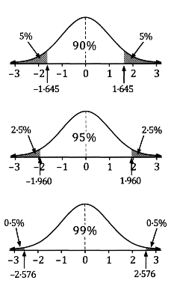
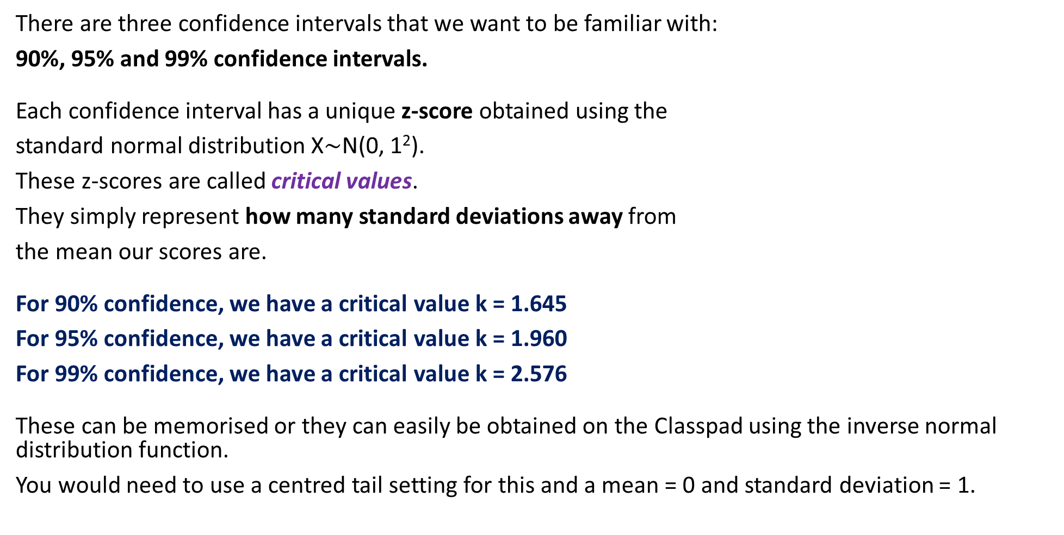
Confidence Intervals
There are three confidence intervals that we want to be familiar with:
90%, 95% and 99% confidence intervals.
Each confidence interval has a unique z-score obtained using the
standard normal distribution X$\sim$N(0, 1²).
These z-scores are called critical values.
They simply represent how many standard deviations away from
the mean our scores are.
For 90% confidence, we have a critical value k = 1.645
For 95% confidence, we have a critical value k = 1.960
For 99% confidence, we have a critical value k = 2.576
These can be memorised or they can easily be obtained on the Classpad using the inverse normal distribution function.
You would need to use a centred tail setting for this and a mean = 0 and standard deviation = 1.

Slide 4
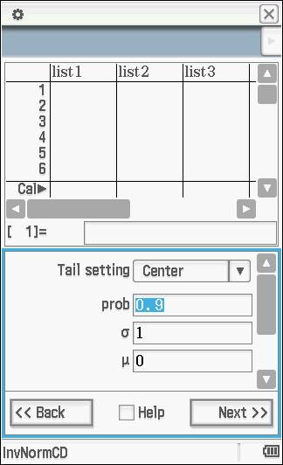
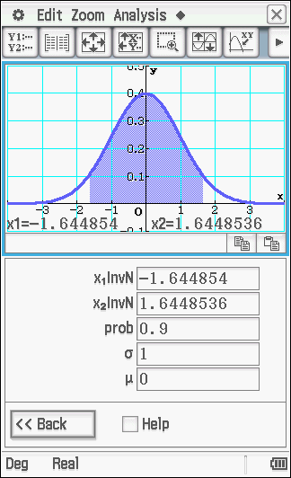
Obtaining Critical Values on the ClassPad
To find the critical value for 90% confidence, we use “Statistics” -> ‘Inverse Distribution’ -> ‘Inv. Norm CD’ -> Tail setting “Center” -> SD as 1, Mean as 0 -> Probability as 0.9, 0.95 or 0.99 depending on the CI you want to find.
We obtain a much more accurate critical value here. While it is preferred that we maintain accuracy (and I would prefer you obtained the critical values via the Classpad) if you memorise the critical values to 3 decimal places and use those that is still acceptable. But note your answers may differ from others.

Slide 5



Calculating a Confidence Interval
To find the interval estimate such that the range shows where the population proportion should lie, the following formula is used to calculate the confidence interval:
$$\hat{p}−k\sqrt{\frac{\hat{p}\left(1−\hat{p}\right)}{n}}≤p≤\hat{p}+k\sqrt{\frac{\hat{p}(1−\hat{p})}{n}}$$
Where p = population proportion
$\hat{p}$ = sample proportion
n = sample size
k = critical value of the confidence interval (Some places uses $z$)
The blue part of the formula:
$$k\sqrt{\frac{\hat{p}\left(1−\hat{p}\right)}{n}}$$
is called the margin of error. It
determines the width of the
interval such that having more
confidence (99%) would require
a larger margin of error than a
smaller confidence interval (90%)
The grey part of the formula:
$$\sqrt{\frac{\hat{p}\left(1−\hat{p}\right)}{n}}$$
is called standard error of the sample proportion not the standard deviation as it has been estimated from the sample data. The SE describes how close the sample proportion $\hat{p}$ will be to the true proportion $p$ in repeated simple random samples of size $n$

Slide 6
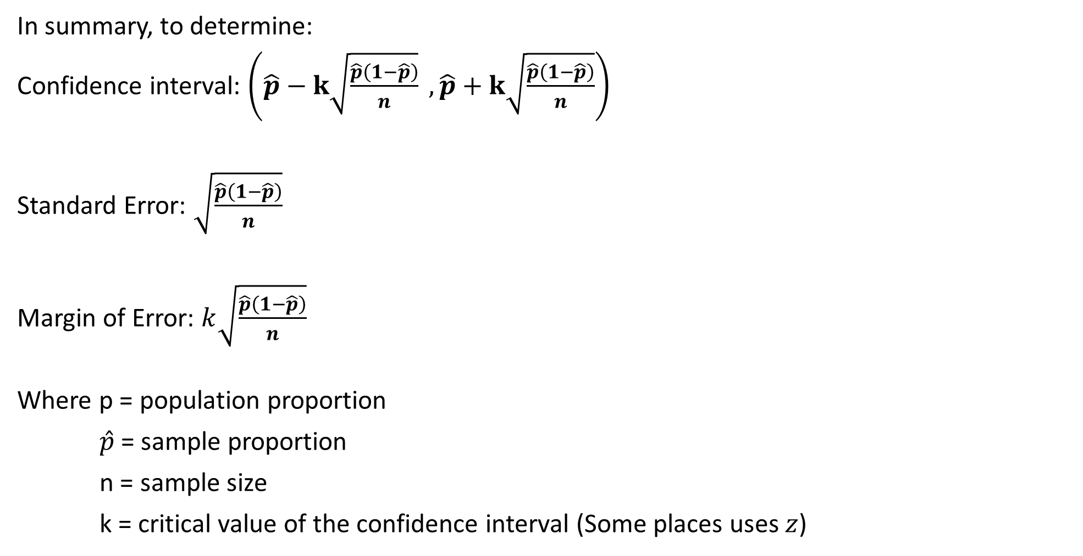
Calculating a Confidence Interval
In summary, to determine:
Confidence interval: $\left(\hat{p}−k\sqrt{\frac{\hat{p}\left(1−\hat{p}\right)}{n}} ,\hat{p}+k\sqrt{\frac{\hat{p}\left(1−\hat{p}\right)}{n}}\right)$
Standard Error: $\sqrt{\frac{\hat{p}\left(1−\hat{p}\right)}{n}}$
Margin of Error: $k\sqrt{\frac{\hat{p}\left(1−\hat{p}\right)}{n}}$
Where p = population proportion
$\hat{p}$ = sample proportion
n = sample size
k = critical value of the confidence interval (Some places uses $z$)

Slide 7
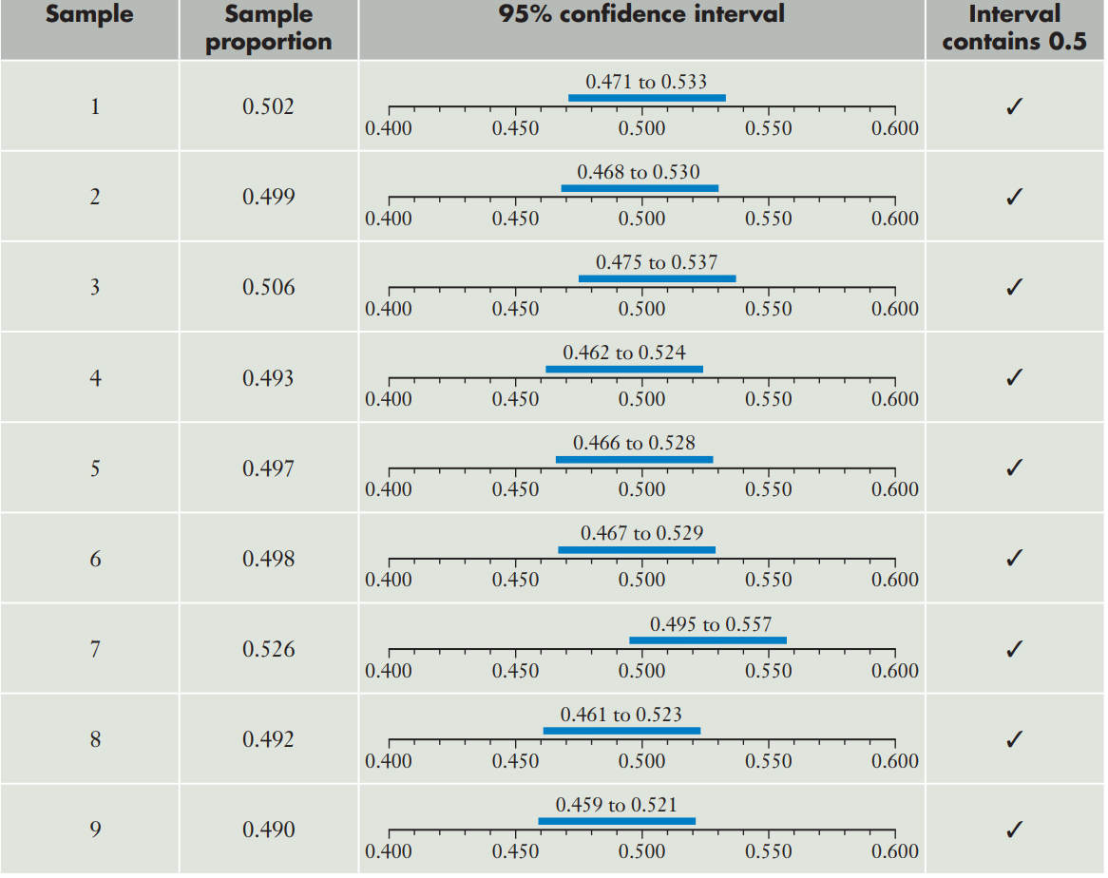
Interpreting a Confidence Interval
Calculate the confidence interval and
Determine if the interval contains the population
proportion of 0.5.

Slide 8
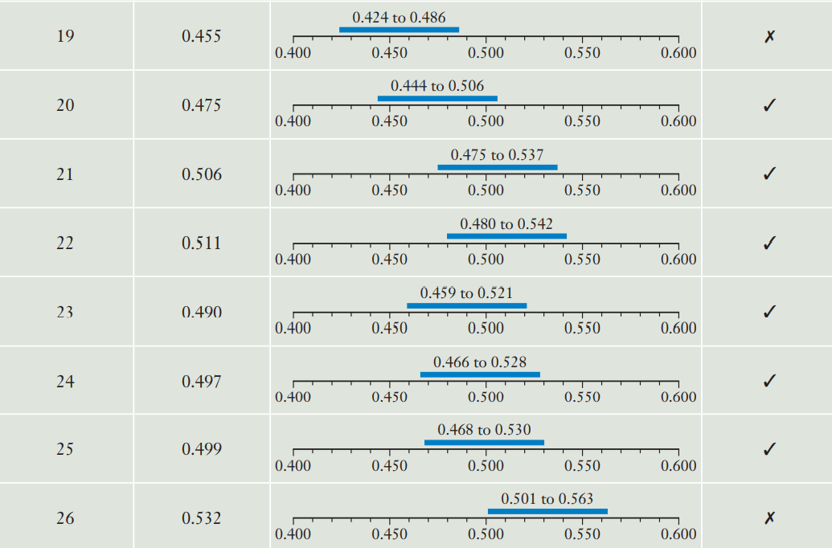
Interpreting a Confidence Interval
Calculate the confidence interval and
Determine if the interval contains the population
proportion of 0.5.

Slide 9
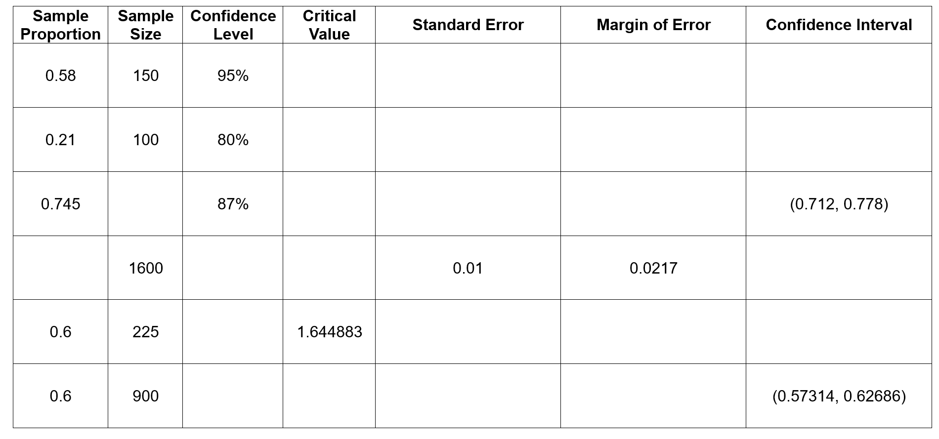
Determining Confidence Intervals, SE and ME
1.96
0.0403
0.0790
(0.5010, 0.6590)
1.2816
0.0407
0.0522
(0.1578, 0.2622)
400
1.5141
0.0218
0.033
0.2 or 0.8
97%
2.17
(0.1783, 0.2217)
(0.7783, 0.8217)
(a)
90%
0.03266
0.05372
(0.54628, 0.65372)
(b)
90%
1.64483
0.01633
0.02686

Slide 10
Guided Practice
Consider the error margins and confidence intervals found in the last two rows of the previous slide. Noting that both samples have the same proportion and confidence level, explain the significance of the difference in their error margins and confidence intervals.
Give a reason for this difference. Assume that both samples were random samples taken from the same population.
The precision in estimating the population proportion is much greater in sample (b) as compared to that of sample (a).
This is indicated by the much narrower width of sample (b)’s confidence interval as compared to that of sample (a).
The greater precision of the estimate of the population proportion of sample (b) is also supported by the smaller margin of error in (b) as compared to (a).
The reason for this difference in precision is due to the fact that the larger the sample size taken, the more precise the estimate.

Slide 11
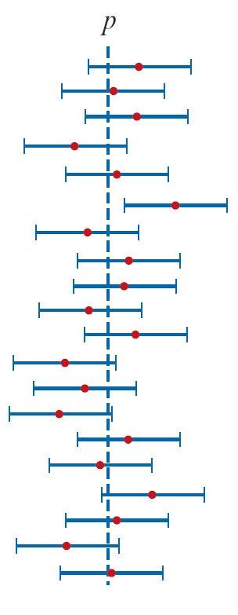
Interpreting a Confidence Interval
Be wary of how you interpret the meaning of a confidence interval.
Very often, students misinterpret the confidence interval as representing the ‘probability that the population proportion lies within a certain range of values’.
This does not make sense as the population proportion is a constant – implying there is a probability that it lies within one interval as opposed to another interval means that the value is no longer constant.
The diagram to the right better illustrates the meaning of confidence intervals. Suppose the intervals shown represent numerous 95% confidence intervals, calculated using 20 different samples.
Note that the intervals should ALL be different because each sample proportion is usually different from each other.
Note that 19 out of the 20 confidence intervals contain the population proportion (represented by the dotted line).

Slide 12
Interpreting a Confidence Interval
So how should we interpret a confidence interval?
Using the example to the right, the interpretation should be:
‘We expect 95% of our 95% confidence intervals to contain the population proportion p.’
If a question asks you whether ONE confidence interval (either 90%, 95% or 99%, or an alternative one) that you have calculated contains the population proportion or not, the interpretation should be:
‘We cannot determine whether this particular confidence interval will contain the population proportion p.’

Slide 13




Guided Practice
A quality-control engineer in a factory needs to estimate the proportion of bags of potato chips packed by a certain machine that are underweight. The engineer takes a random sample of 100 bags and finds that eight of them are underweight.
Find a point estimate for $p$, the proportion of bags packed by the machine that are underweight.
Calculate a 95% confidence interval for $p$ and interpret what this means.
a) $p=\frac{8}{100}=0.08$
b) Critical value: $k=1.959964$
`Confidence Interval $=\left(0.08−1.959964\sqrt{\frac{0.08\left(1−0.08\right)}{100}},0.8+1.959964\sqrt{\frac{0.08\left(1−0.08\right)}{100}}\right)$
$$=\left(0.02683,0.1332\right)$$
We are 95% confident that the proportion of bags of potato packed by a certain machine that are underweight will be between $0.02683$ and $0.1332$.

Slide 14

Calculating Confidence Intervals on the ClassPad
We can calculate confidence intervals on your ClassPad:
(Check the marks allocation. You may need to show the substitution into formula, and marks may be allocated for identifying the critical value)
Go to Statistics
Go to Calc → Interval
Change One-Sample Z Int to One-Prop Z Int
In the settings for One-Prop Z Int:
C-Level is the confidence level (0.9, 0.95 or 0.99)
x is the recorded score (x=56)
n is the sample size (n= 250)

Slide 15
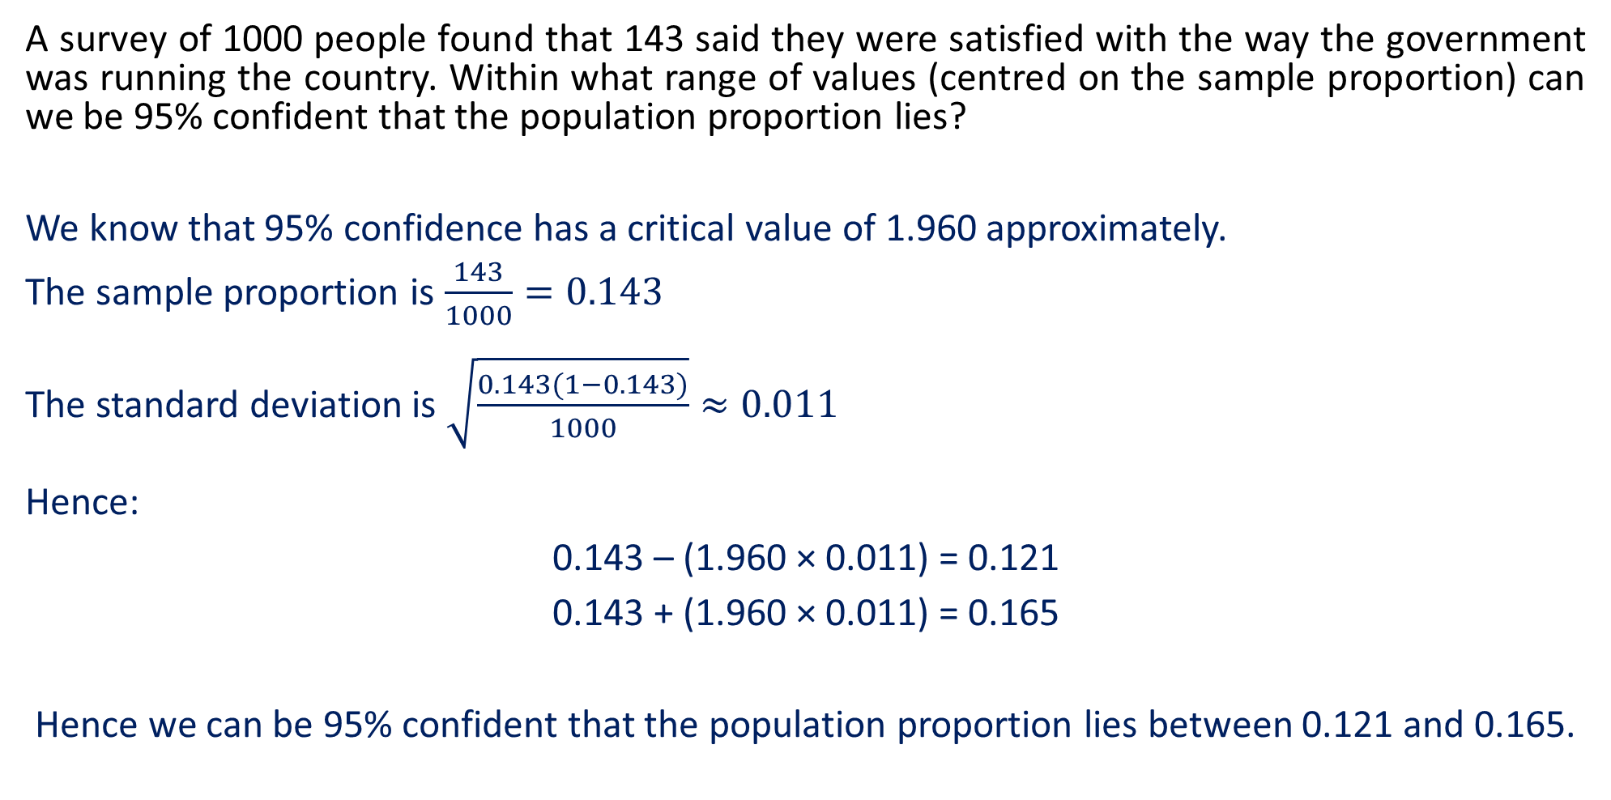
Guided Practice
A survey of 1000 people found that 143 said they were satisfied with the way the government was running the country. Within what range of values (centred on the sample proportion) can we be 95% confident that the population proportion lies?
We know that 95% confidence has a critical value of 1.960 approximately.
The sample proportion is $\frac{143}{1000}=0.143$
The standard deviation is $\sqrt{\frac{0.143(1−0.143)}{1000}}≈0.011$
Hence:
0.143 – (1.960 × 0.011) = 0.121
0.143 + (1.960 × 0.011) = 0.165
Hence we can be 95% confident that the population proportion lies between 0.121 and 0.165.

Slide 16
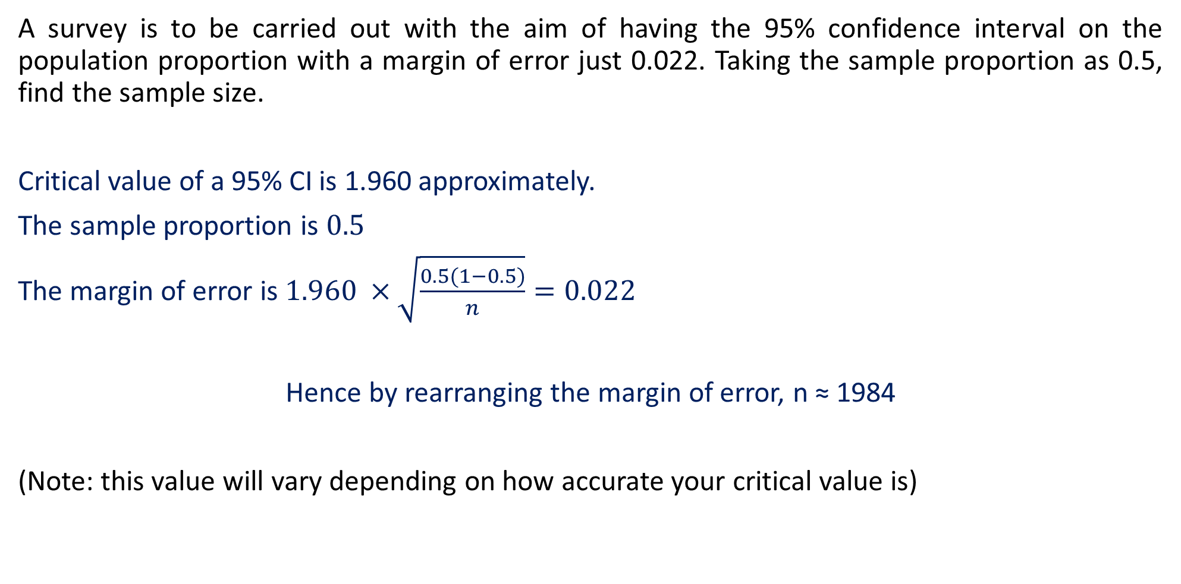
Guided Practice
A survey is to be carried out with the aim of having the 95% confidence interval on the population proportion with a margin of error just 0.022. Taking the sample proportion as 0.5, find the sample size.
Critical value of a 95% CI is 1.960 approximately.
The sample proportion is $0.5$
The margin of error is $1.960 ×\sqrt{\frac{0.5(1−0.5)}{n}}=0.022$
Hence by rearranging the margin of error, n ≈ 1984
(Note: this value will vary depending on how accurate your critical value is)

Slide 17

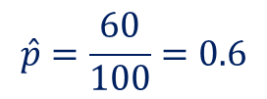


Guided Practice
When a coin thought to be biased was tossed 100 times, it came up heads 60 times. Calculate and compare 90%, 95% and 99% confidence intervals for the probability of observing a head when that coin is tossed.
$$\hat{p}=\frac{60}{100}=0.6$$
90% Confidence Interval $=\left(0.6−1.6448536\sqrt{\frac{0.6\left(1−0.6\right)}{100}},0.6+1.6448536\sqrt{\frac{0.6\left(1−0.6\right)}{100}}\right)$
$$=\left(0.5194,0.6805\right)$$
95% Confidence Interval $=\left(0.6−1.959964\sqrt{\frac{0.6\left(1−0.6\right)}{100}},0.6+1.959964\sqrt{\frac{0.6\left(1−0.6\right)}{100}}\right)$
$$=\left(0.5040,0.6960\right)$$
99% Confidence Interval $=\left(0.6−2.5758293\sqrt{\frac{0.6\left(1−0.6\right)}{100}},0.6+2.5758293\sqrt{\frac{0.6\left(1−0.6\right)}{100}}\right)$
$$=\left(0.4738, 0.7262\right)$$
As the level of confidence increases, the width of the confidence interval increases as the margin of error increases as such, the 99% confidence interval will have the widest interval followed by 95% and 90% with the narrowest interval.
To be more confident that the interval will capture the true value of the population proportion, a wider confidence interval will be required.

Slide 18
Guided Practice (2019 WACE Calc-Assumed)
Big Foods is a large supermarket company. The manager wants to estimate the proportion of households that do the majority of their grocery shopping in their stores. A junior staff member at Big Foods conducted a survey of 250 randomly-selected households and found that 56 did the majority of their grocery shopping at a Big Foods store.
i) Calculate the sample proportion of households who did the majority of their grocery shopping at Big Foods.
ii) Determine the 95% confidence interval for the proportion of households who do the
majority of their grocery shopping at Big Foods. Give your answer to four decimal places.
iii) What is the margin of error of the 95% confidence interval? Give your answer to four
decimal places.
An independent survey company conducted a large-scale survey of household supermarket preferences and estimated that the true proportion of households that conduct most of their grocery shopping at Big Foods was 0.17 (assume that this is indeed the true proportion).
b) With reference to your answer to part a) ii) , does this result suggest that the junior staff member at Big Foods made a mistake?

Slide 19
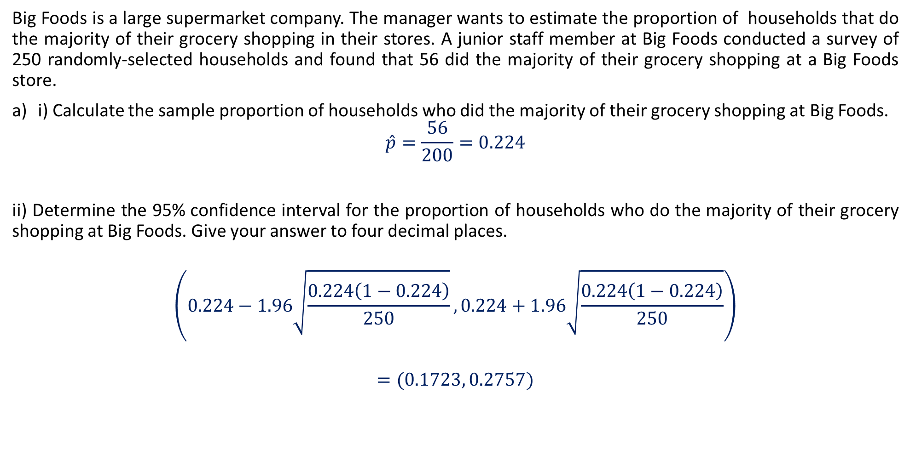
Guided Practice (2019 WACE Calc-Assumed)
Big Foods is a large supermarket company. The manager wants to estimate the proportion of households that do the majority of their grocery shopping in their stores. A junior staff member at Big Foods conducted a survey of 250 randomly-selected households and found that 56 did the majority of their grocery shopping at a Big Foods store.
i) Calculate the sample proportion of households who did the majority of their grocery shopping at Big Foods.
$$\hat{p}=\frac{56}{200}=0.224$$
ii) Determine the 95% confidence interval for the proportion of households who do the majority of their grocery shopping at Big Foods. Give your answer to four decimal places.
$$\left(0.224−1.96\sqrt{\frac{0.224\left(1−0.224\right)}{250}},0.224+1.96\sqrt{\frac{0.224\left(1−0.224\right)}{250}}\right)$$
$$=(0.1723, 0.2757)$$

Slide 20
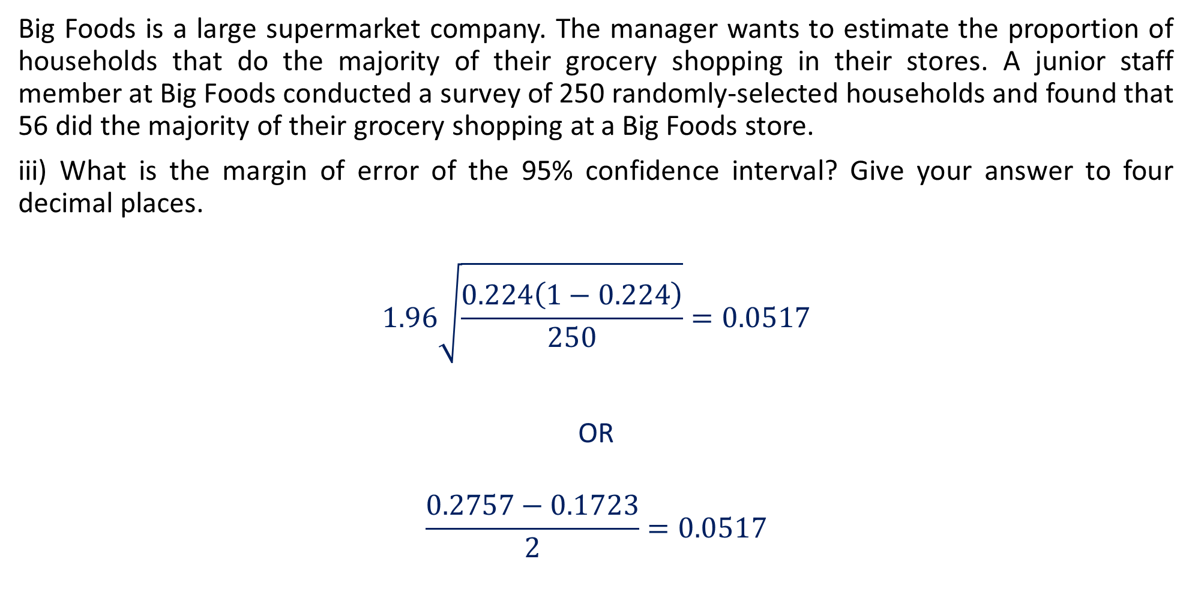
Guided Practice (2019 WACE Calc-Assumed)
Big Foods is a large supermarket company. The manager wants to estimate the proportion of households that do the majority of their grocery shopping in their stores. A junior staff member at Big Foods conducted a survey of 250 randomly-selected households and found that 56 did the majority of their grocery shopping at a Big Foods store.
iii) What is the margin of error of the 95% confidence interval? Give your answer to four decimal places.
$$1.96\sqrt{\frac{0.224\left(1−0.224\right)}{250}}=0.0517$$
OR
$$\frac{0.2757−0.1723}{2}=0.0517$$

Slide 21
Guided Practice (2019 WACE Calc-Assumed)
An independent survey company conducted a large-scale survey of household supermarket preferences and estimated that the true proportion of households that conduct most of their grocery shopping at Big Foods was 0.17 (assume that this is indeed the true proportion).
b) With reference to your answer to part a) ii) , does this result suggest that the junior staff member at Big Foods made a mistake?
No, because we know that 95% of the 95% confidence intervals are expected to contain the true population proportion. It is possible that the survey and calculation conducted by the junior staff member was performed appropriately, but happened to yield one of the 5% of the confidence intervals that do not contain the true proportion.

Slide 22
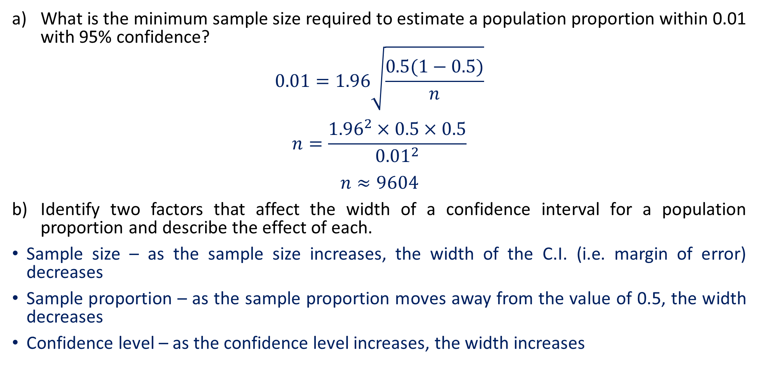
Guided Practice (2019 WACE Calc-Assumed)
What is the minimum sample size required to estimate a population proportion within 0.01 with 95% confidence?
$$0.01=1.96\sqrt{\frac{0.5(1−0.5)}{n}}$$
$$n=\frac{{1.96}^{2}×0.5×0.5}{{0.01}^{2}}$$
$$n≈9604$$
Identify two factors that affect the width of a confidence interval for a population proportion and describe the effect of each.
Sample size – as the sample size increases, the width of the C.I. (i.e. margin of error) decreases
Sample proportion – as the sample proportion moves away from the value of 0.5, the width decreases
Confidence level – as the confidence level increases, the width increases
When the population proportion is
not given, we use the conservative
estimate for p = 0.5.
0.5 maximises the numerator in the
margin of error.

Slide 23
Independent Practice
Cambridge Ex 12D
Jklup WS Ex 6D – 6F

